Slide 1
Python Lesson
Understanding Python Traceback

Slide 2
By the end of this session, you’ll be able to:
Make sense of the next traceback you see
Recognize some of the more common tracebacks

Slide 3
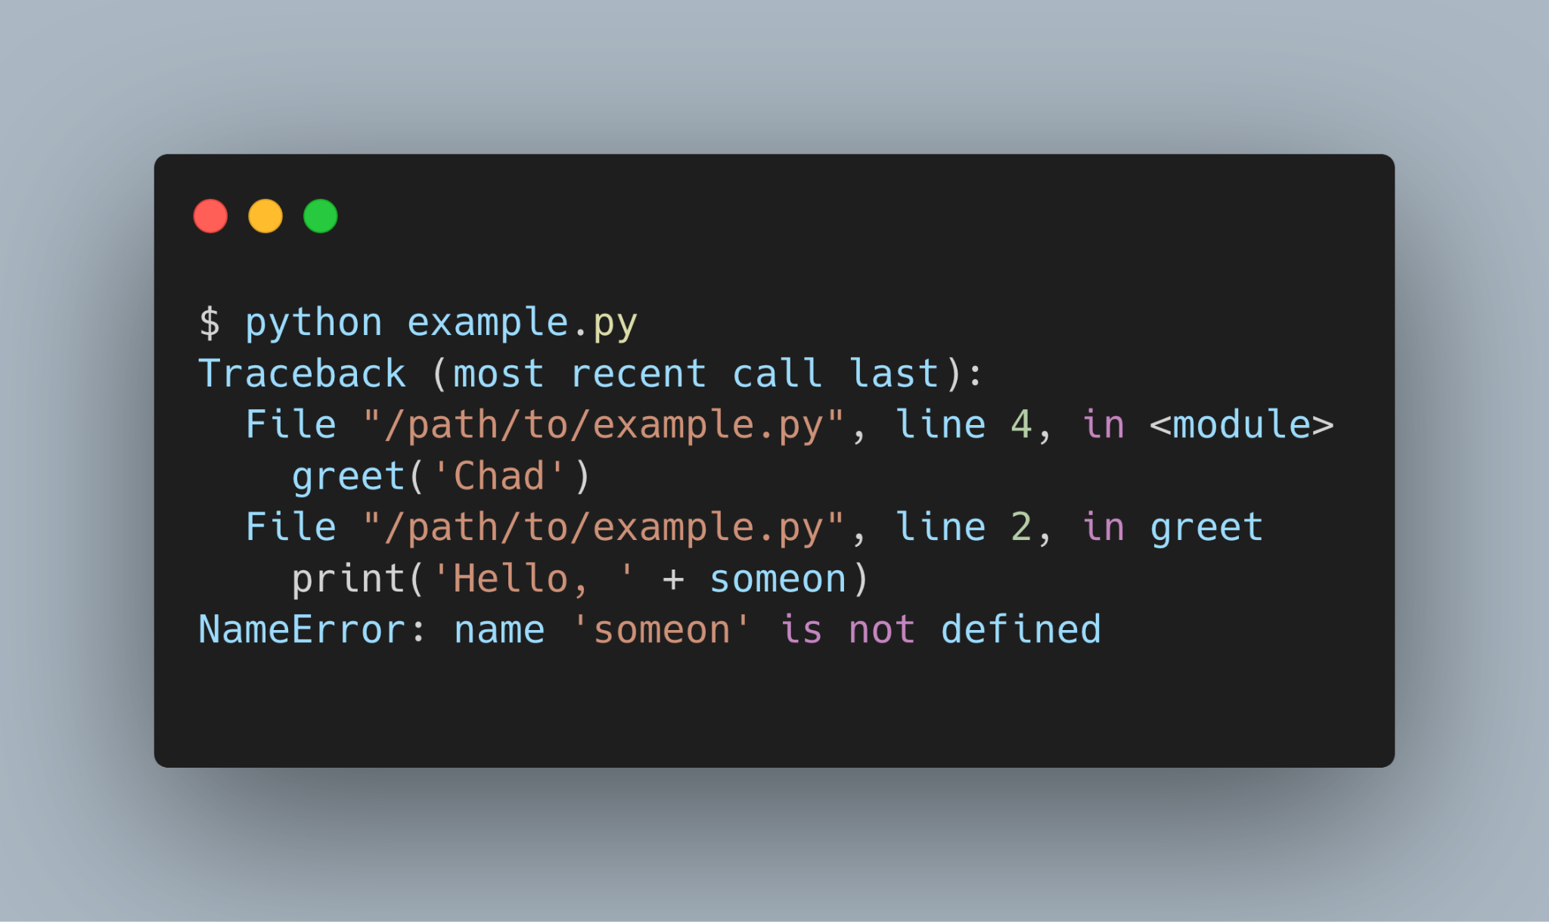
What is the root cause of error?

Slide 4
What is the root cause of error?
Exception Type : NameError
'someon' is not defined
What is that mean name 'someon' is not defined?

Slide 5
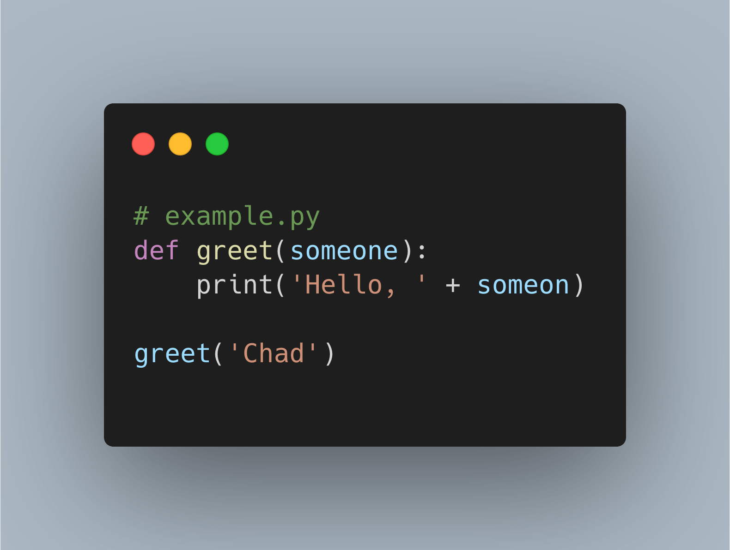

Slide 6
What Is a Python Traceback?
A traceback is a report containing the function calls made in your code at a specific point.
When your program results in an exception, Python will print the current traceback to help you know what went wrong.

Slide 7
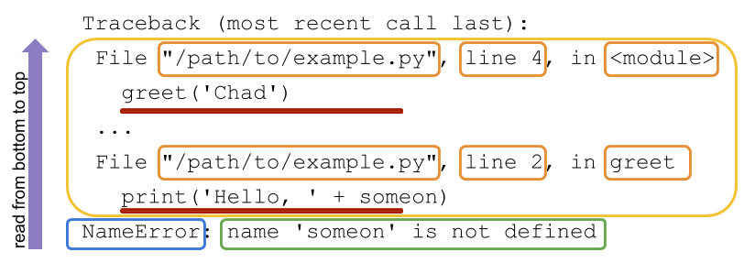
How Do You Read a Python Traceback?
Blue box: It contains the exception name that was raised.
Green box: After the exception name is the error message. This message usually contains helpful information for understanding the reason for the exception being raised.

Slide 8
How Do You Read a Python Traceback?
Yellow box: The first line of each call contains information like the file name, line number, and module name, all specifying where the code can be found.
Red underline: The second line for these calls contains the actual code that was executed.

Slide 9
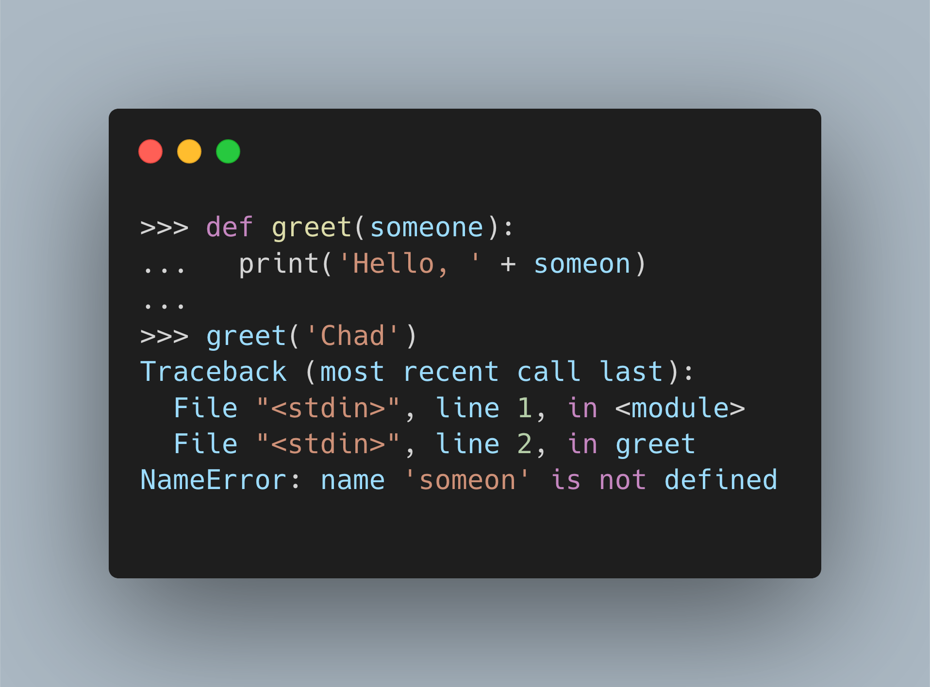
How Do You Read a Python Traceback?
There are a few differences between traceback output when you’re
executing your code in the command-line and running code in the REPL.
REPL stands for Read, Evaluate, Print, Loop. The REPL is how you interact with the Python Interpreter.

Slide 10
How Do You Read a Python Traceback?
Notice that in place of file names, you get "<stdin>".
This makes sense since you typed the code in through standard input.

Slide 11
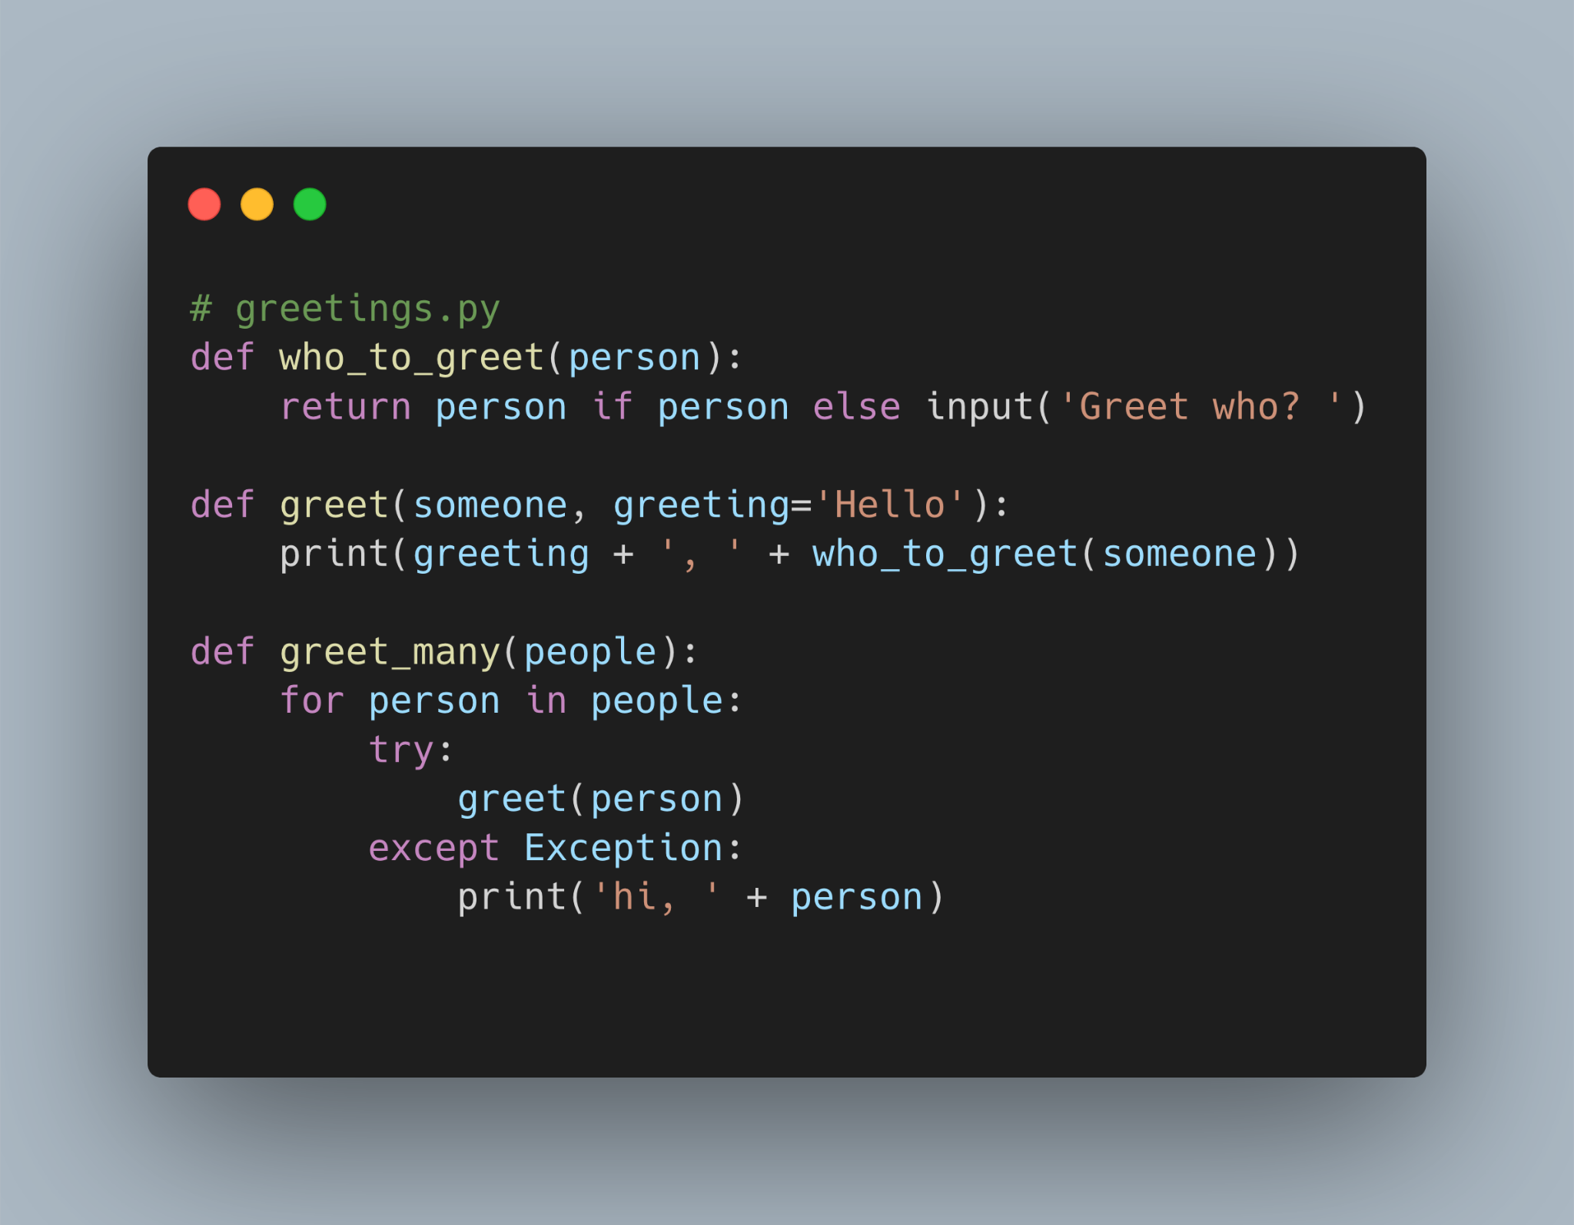

Specific Traceback Walkthrough
Give a 5 minutes to find an error

Slide 12
Specific Traceback Walkthrough
This code doesn’t have any bugs that would result in an exception being raised as long as the right input is provided.

Slide 13
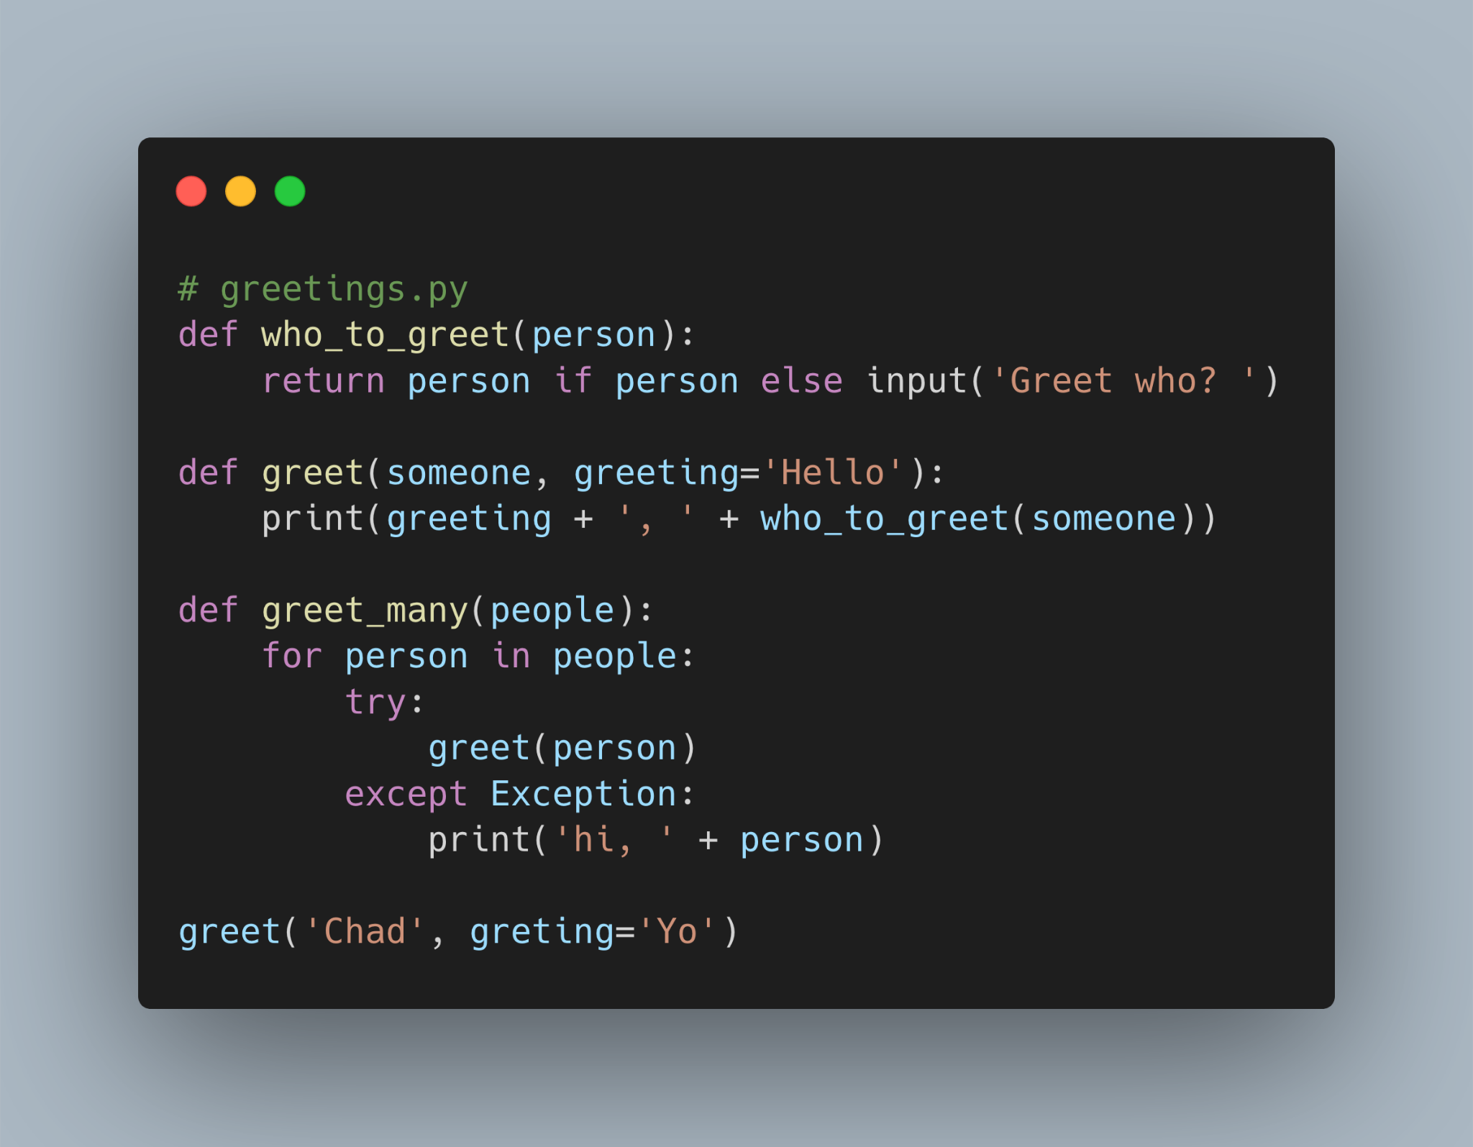
Specific Traceback Walkthrough
What is an error will show?
When we execute this file

Slide 14
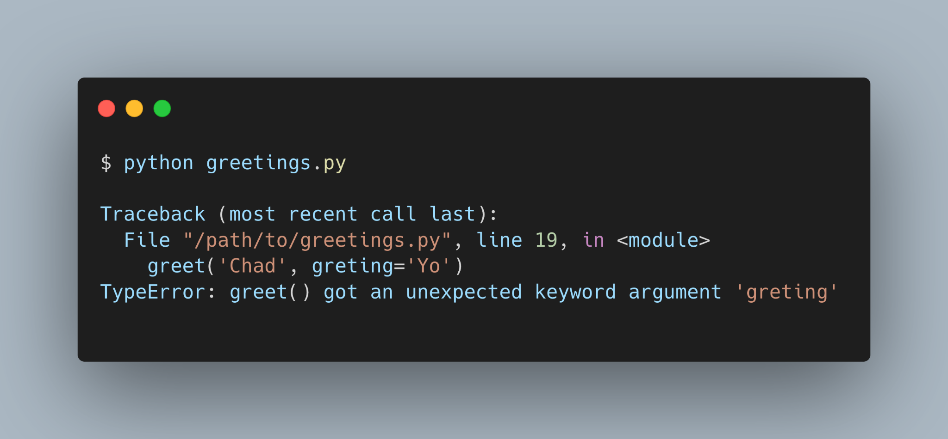
Specific Traceback Walkthrough

Slide 15
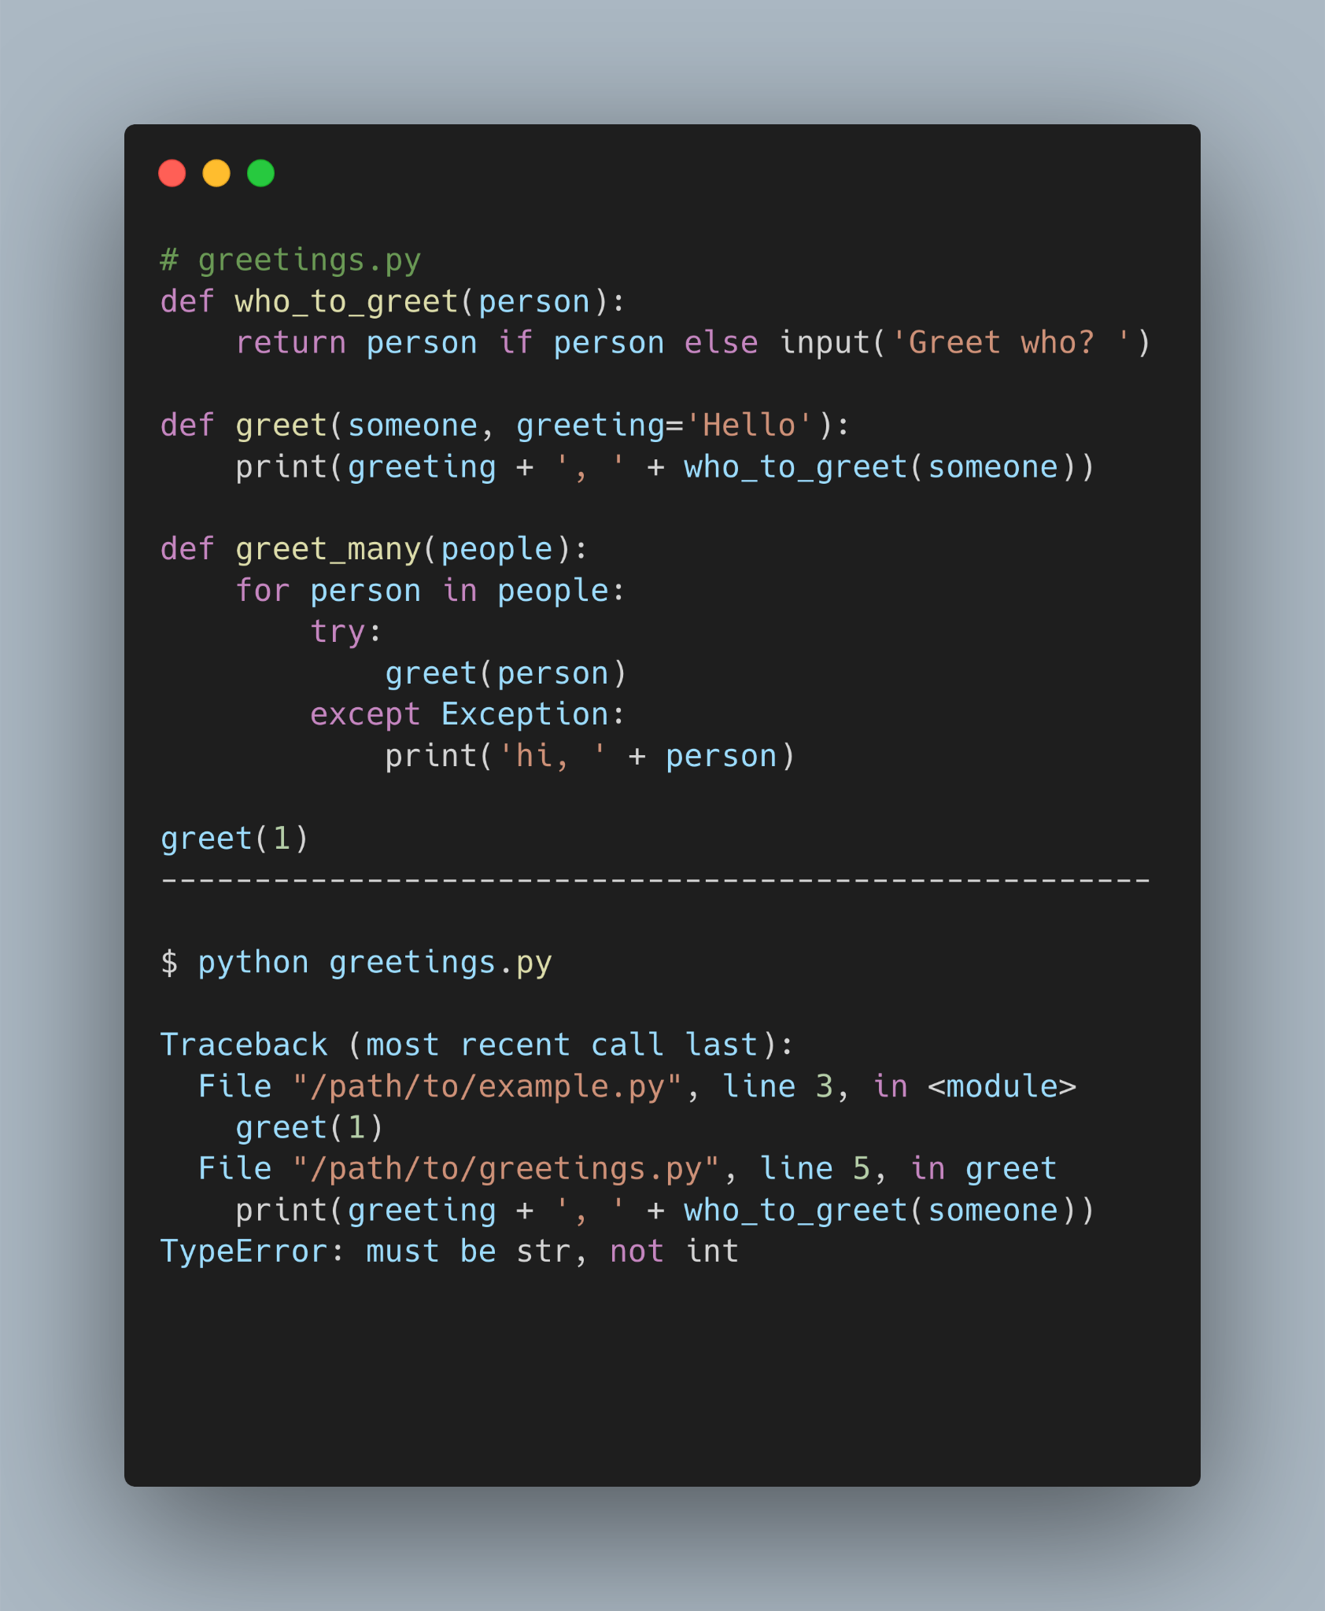
Specific Traceback Walkthrough
Why is show an error?

Slide 16
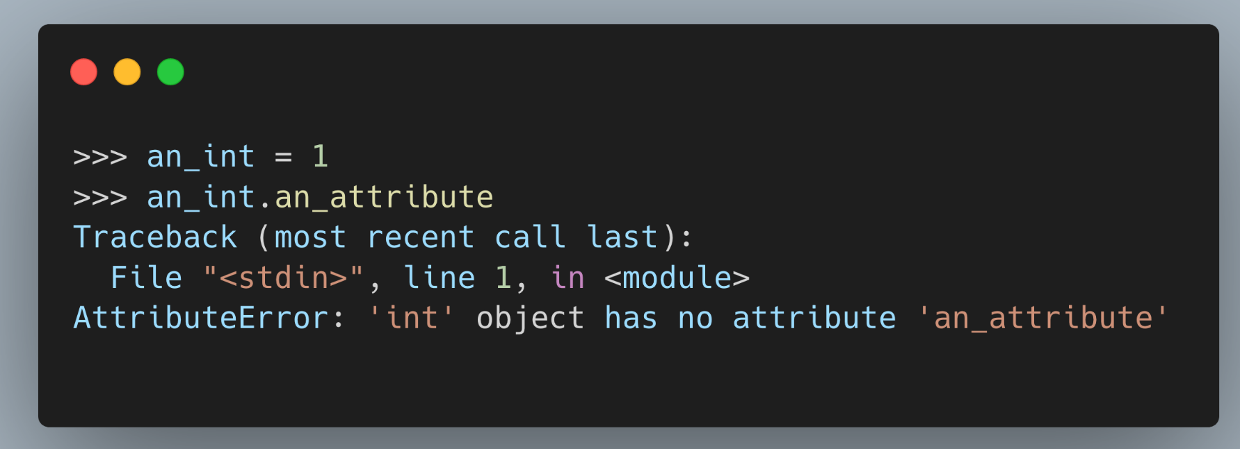
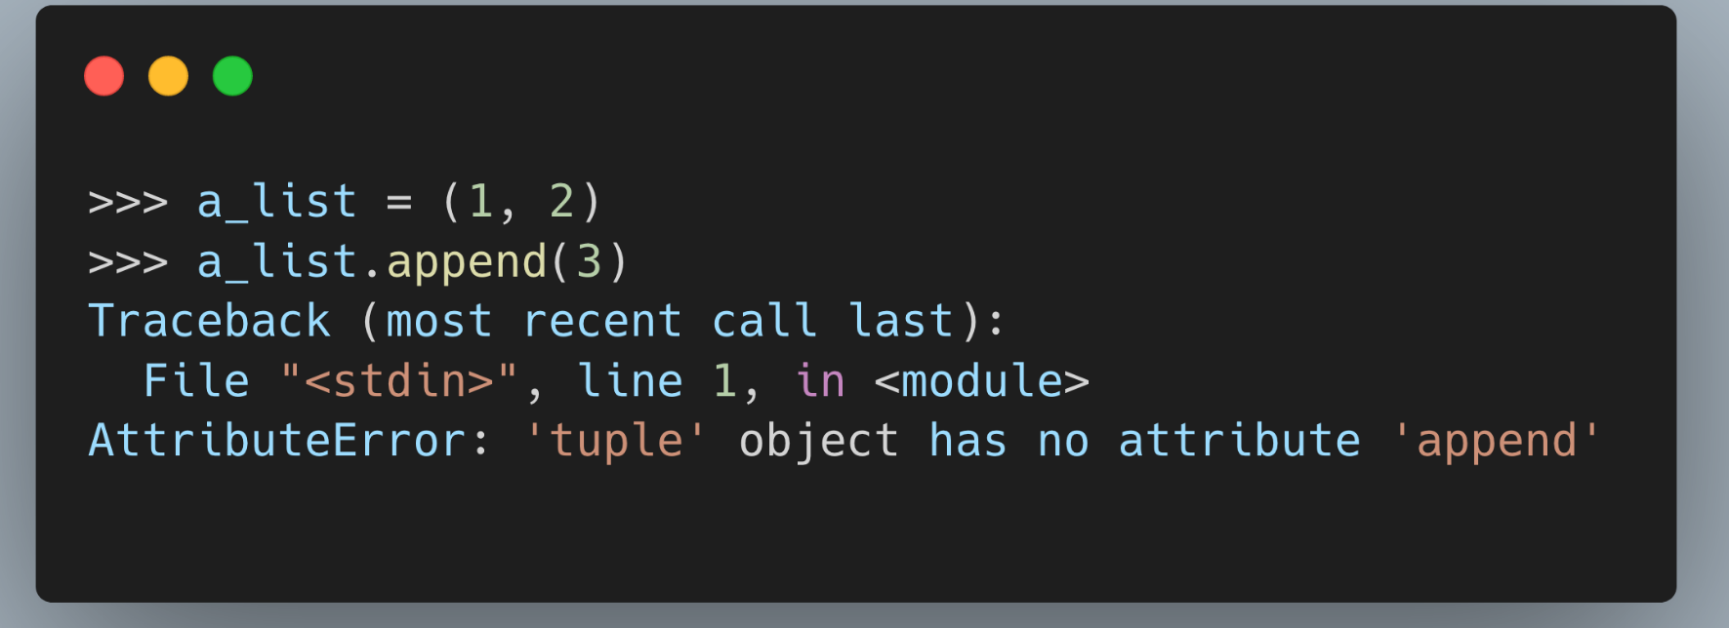
Common Tracebacks in Python
AttributeError
The AttributeError is raised when you try to access an attribute on an object that doesn’t have that attribute defined.

Slide 17
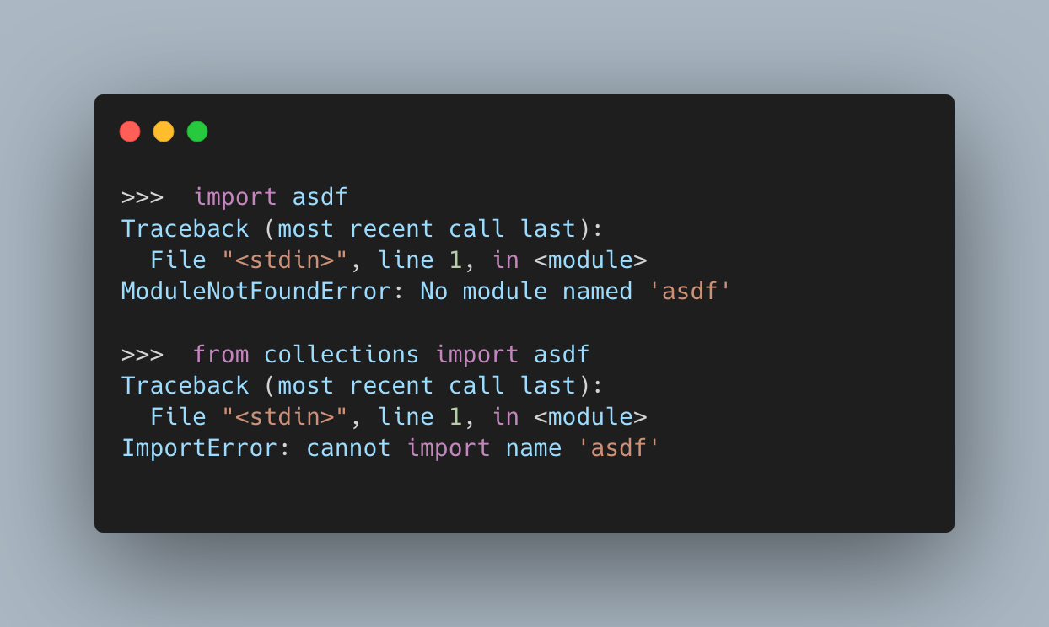
Common Tracebacks in Python
ImportError
The ImportError is raised when something goes wrong with an import statement.
You’ll get this exception, or its subclass ModuleNotFoundError,
if the module you are trying to import can’t be found or a module doesn’t exist in the module.

Slide 18
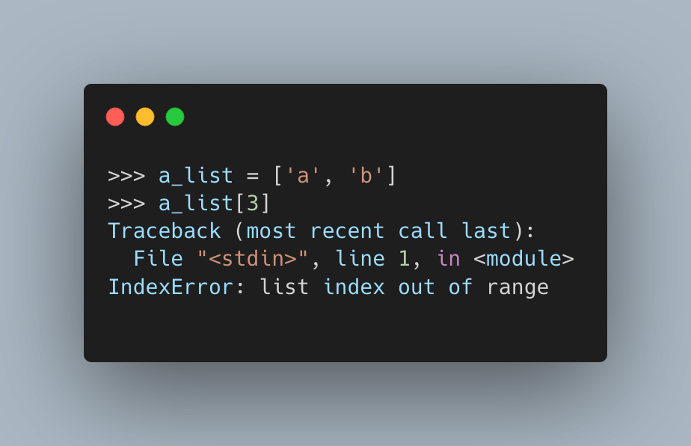
Common Tracebacks in Python
IndexError
The IndexError is raised when you attempt to retrieve an index from a sequence, like a list or a tuple, and the index isn’t found in the sequence.

Slide 19
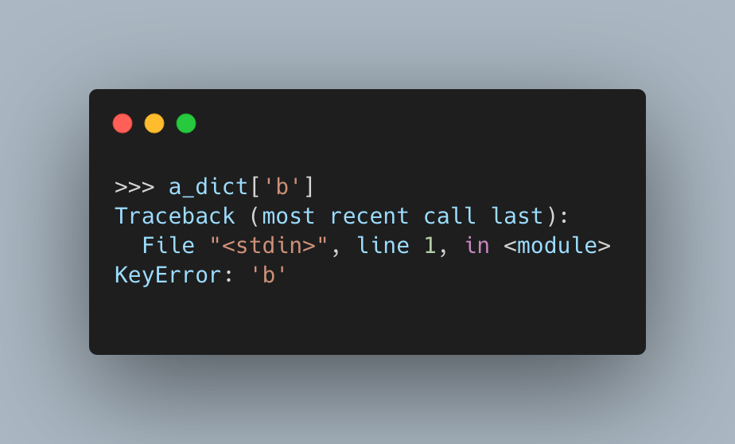
Common Tracebacks in Python
KeyError
Similar to the IndexError, the KeyError is raised when you attempt to access a key that isn’t in the mapping, usually a dict. Think of this as the IndexError but for dictionaries.

Slide 20
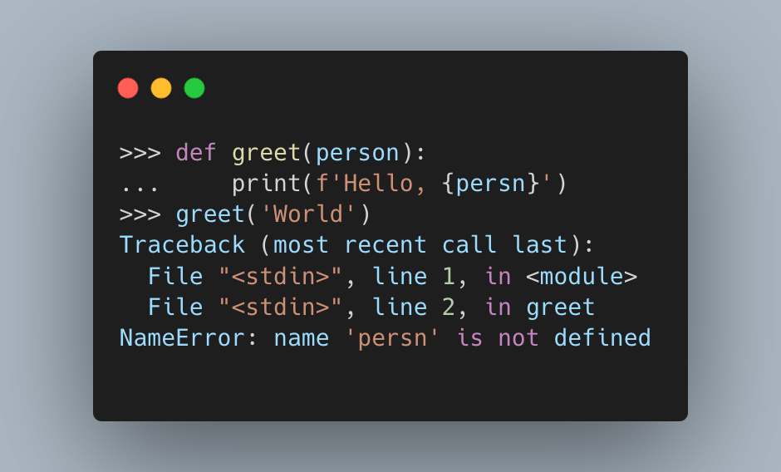
Common Tracebacks in Python
NameError
The NameError is raised when you have referenced a variable, module, class, function, or some other name that hasn’t been defined in your code.

Slide 21
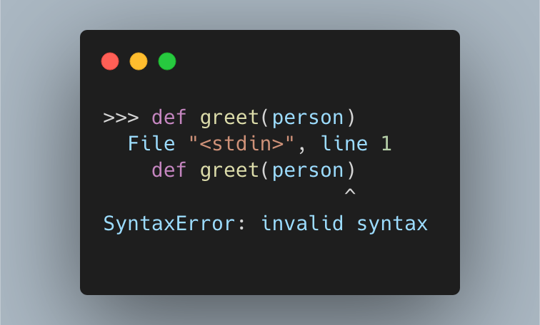
Common Tracebacks in Python
SyntaxError
The SyntaxError is raised when you have incorrect Python syntax in your code.

Slide 22
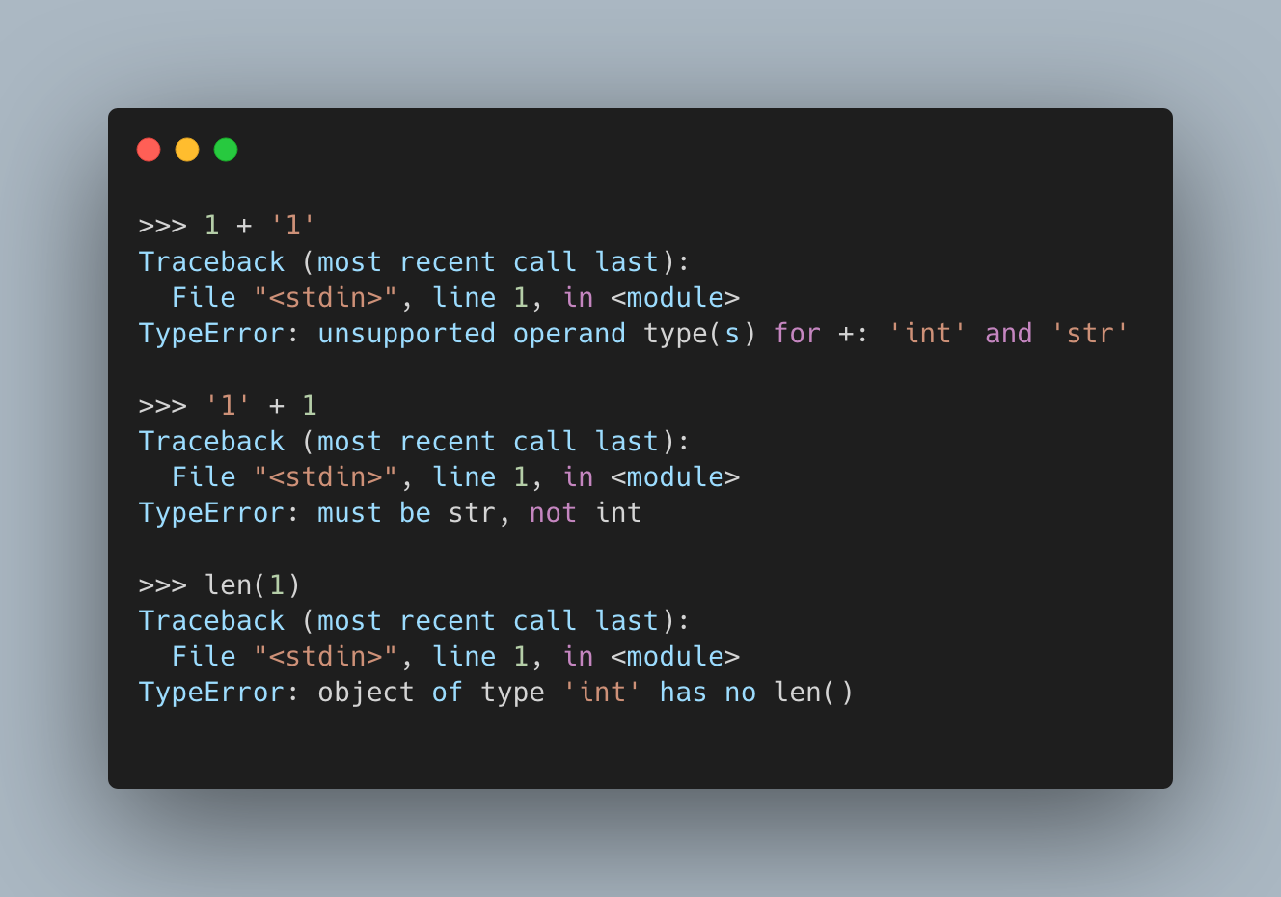
Common Tracebacks in Python
TypeError
The TypeError is raised when your code attempts to do something with an object that can’t do that thing, such as trying to add a string to an integer or calling len() on an object where its length isn’t defined.

Slide 23
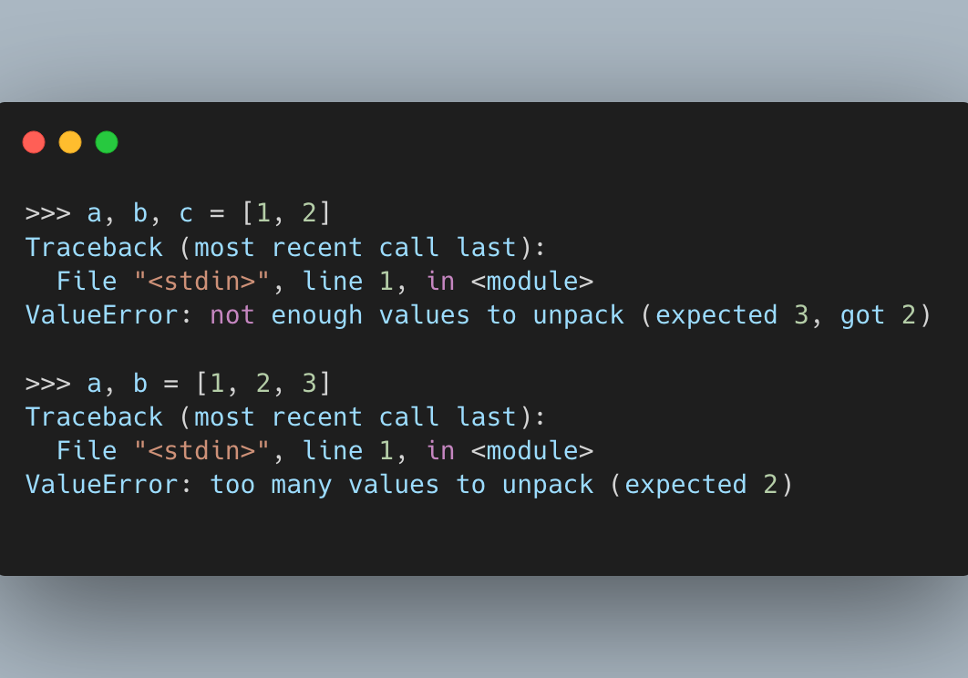
Common Tracebacks in Python
ValueError
is raised when the value of the object isn’t correct. You can think of this as an IndexError that is raised because the value of the index isn’t in the range of the sequence, only the ValueError is for a more generic case.

Slide 24
Q&A

Slide 25
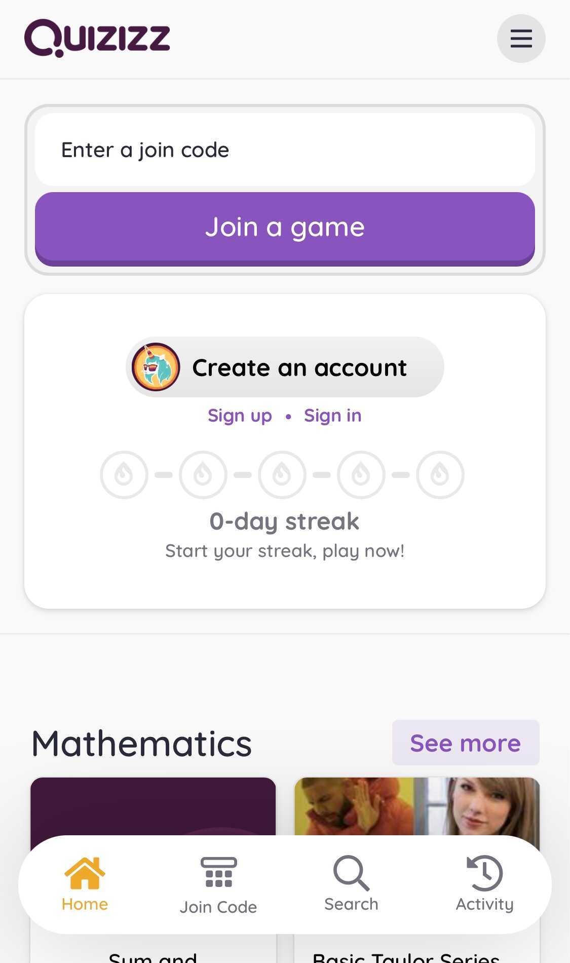
Let play game
To play this quiz
1. Use any device to open
joinmyquiz.com

Slide 26
Thank you

